Slide 1

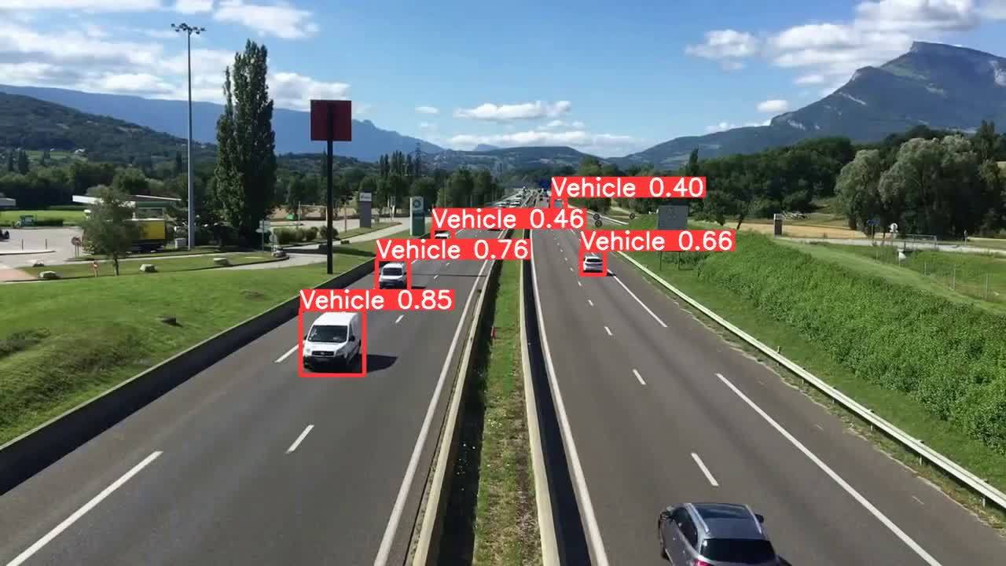
Mini Project 3
Vehicle Detection
Car Detection using YOLO v8
Presented To
Presented By
Group 4
Feras Alsayigh
Abdullah Aloufi
Noura Aldawsari
Mashael Aljohani

Slide 2
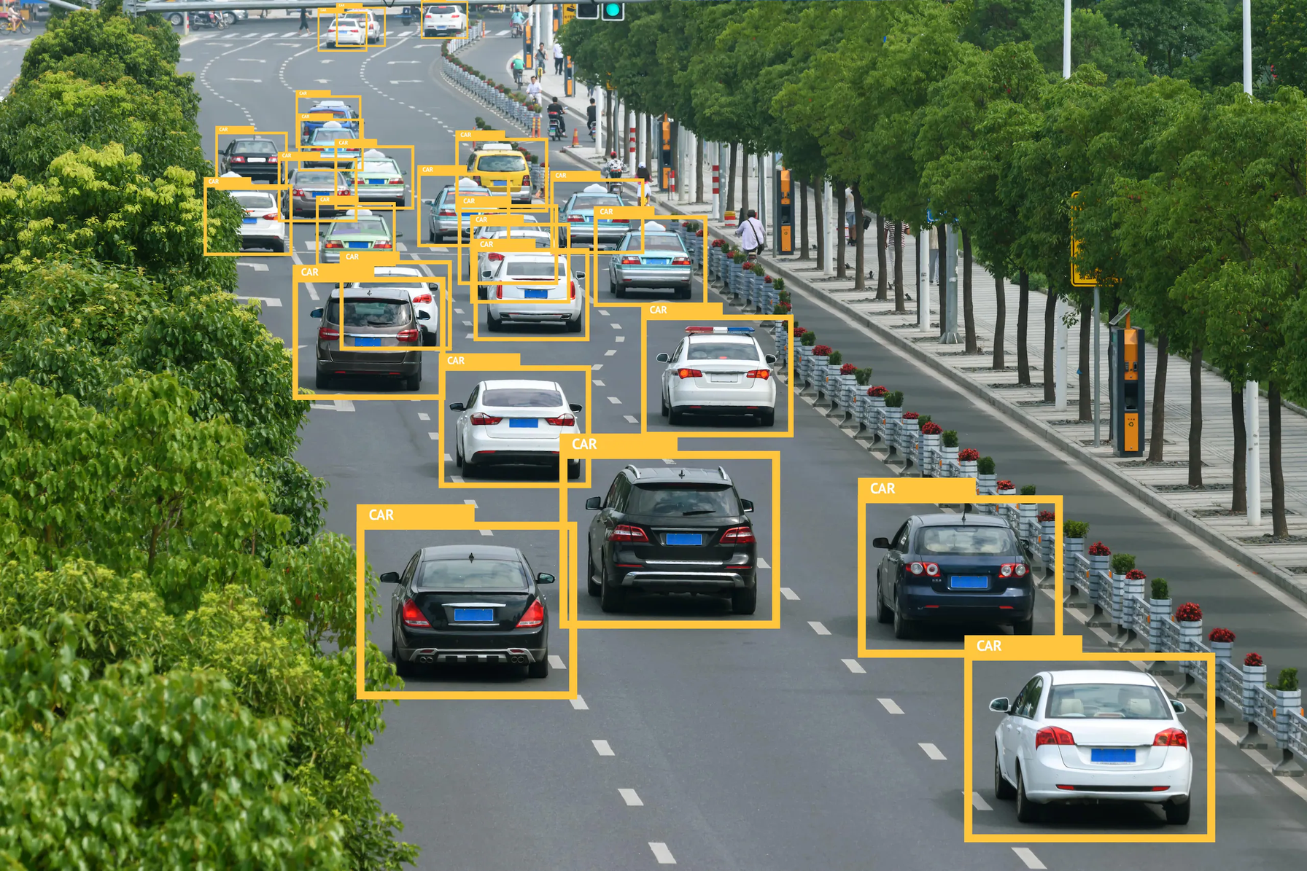
1 | Introduction
2 | Objective of the project
3 | Workflow
4 | Data Gathering
5 | Model Choosing
6 | Result
7 | Summary of results
8 | Conclusion
Agenda

Slide 3
Introduction
In today’s crowded cities, managing traffic efficiently is more important than ever. Our project harnesses the power of YOLO’s detection to estimate traffic density by detecting vehicles in images. This information helps us pinpoint the most congested areas, offering valuable insights for traffic managers. Ultimately, we’re developing a solution that provides a clear picture of traffic flow and patterns, paving the way for smarter traffic management and better urban planning.

Slide 4

BACK TO AGENDA
Objective of the project
YOLOv8 Model Selection and Initial Assessment
Starting with YOLOv8's pre-trained model selection, assessing its initial performance on car dataset for vehicle detection.
Model Fine-Tuning for Enhanced Vehicle Detection
Employing transfer learning to fine-tune the YOLOv8 model, focusing on vehicle detection from aerial perspectives for improved precision and recall.
Comprehensive Model Performance Evaluation:
Analyzing learning curves, evaluating confusion matrix, and assessing performance metrics to validate the model's accuracy and generalization capabilities.

Slide 5
BACK TO AGENDA
Project Workflow
Briefly elaborate on our workflow.
Data Gathering
Choosing Model
Fine Tune
Test The Model
we used labelled data since it is the best for YOLO v8
Best results shows in YOLO for object detection tasks
Usually we fine tune the pre train models on our data for more accurate results
Test our fine tuned model on unseen data

Slide 6
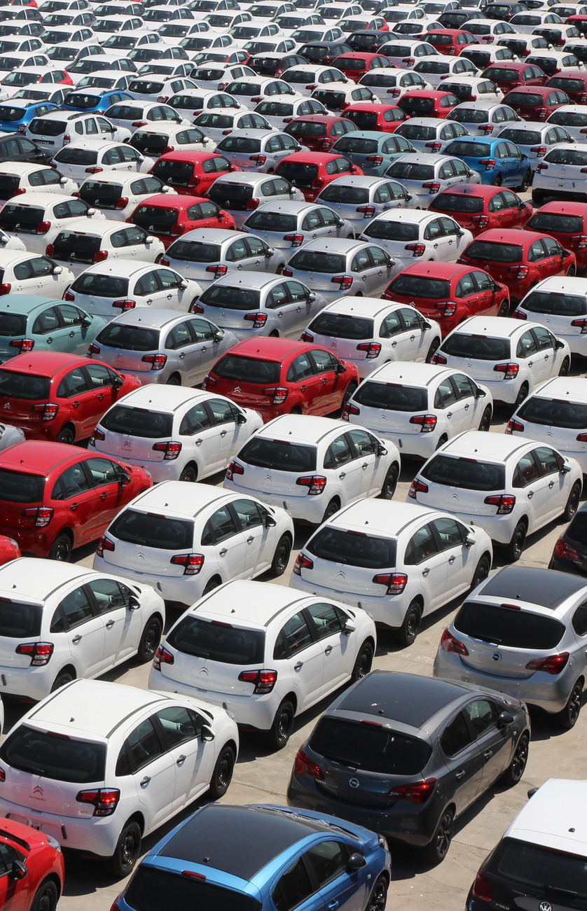

BACK TO AGENDA
Data Gathering
We Used an open-sources labelled data.
Contains around 600 images with its labels.
Suitable for YOLO v8.

Slide 7

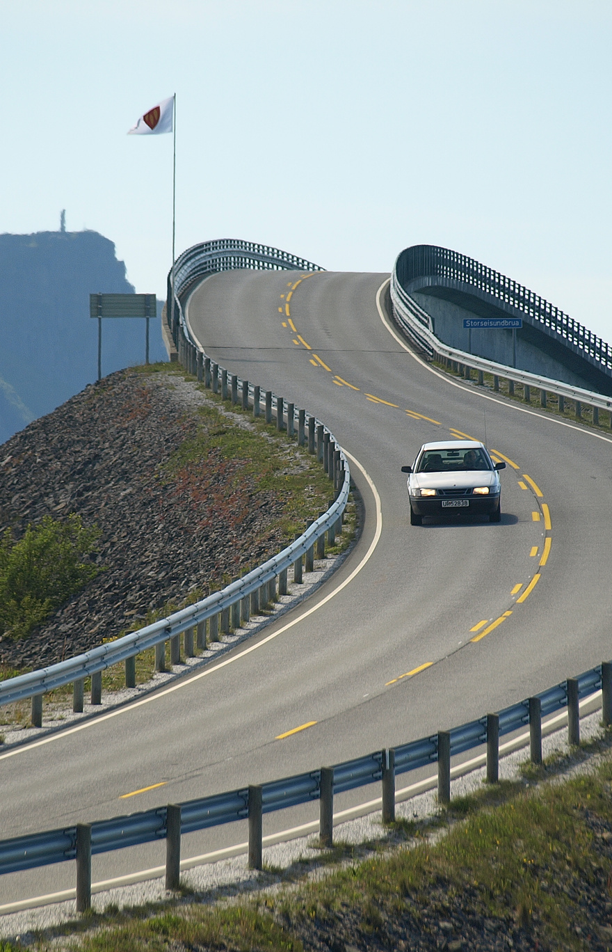

BACK TO AGENDA
Model Choosing
We used YOLO because it is the best in object detection task.
We used yolov8n for fast & accurate results.

Slide 8
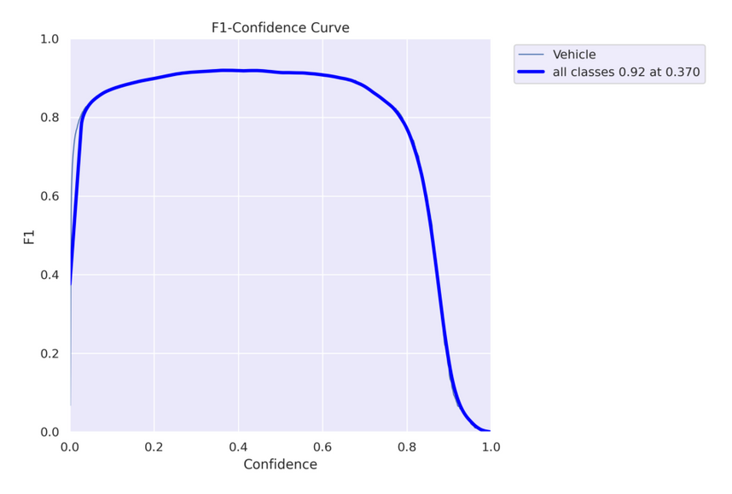
BACK TO AGENDA
Results
using different metrices to show
how well the model performs
F1 -Curve

Slide 9
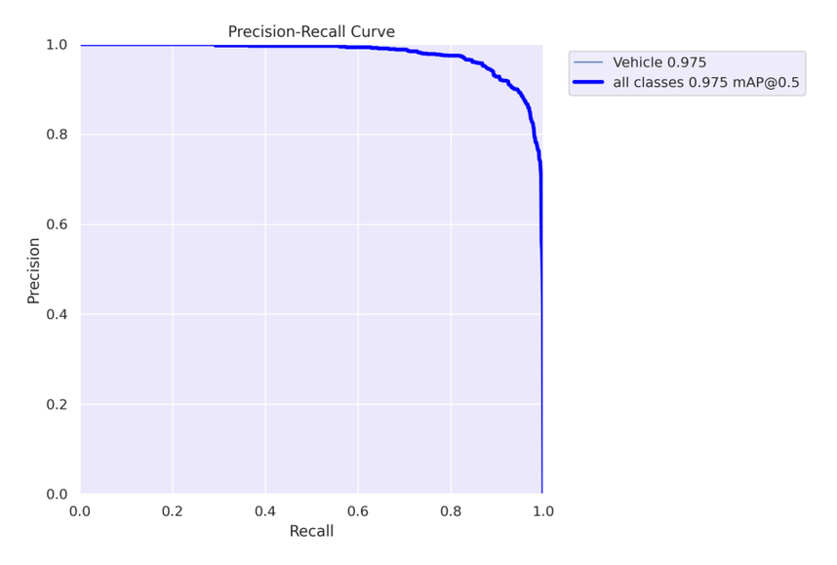
BACK TO AGENDA
Results
using different metrices to show
how well the model performs
Precision & Recall Curve

Slide 10
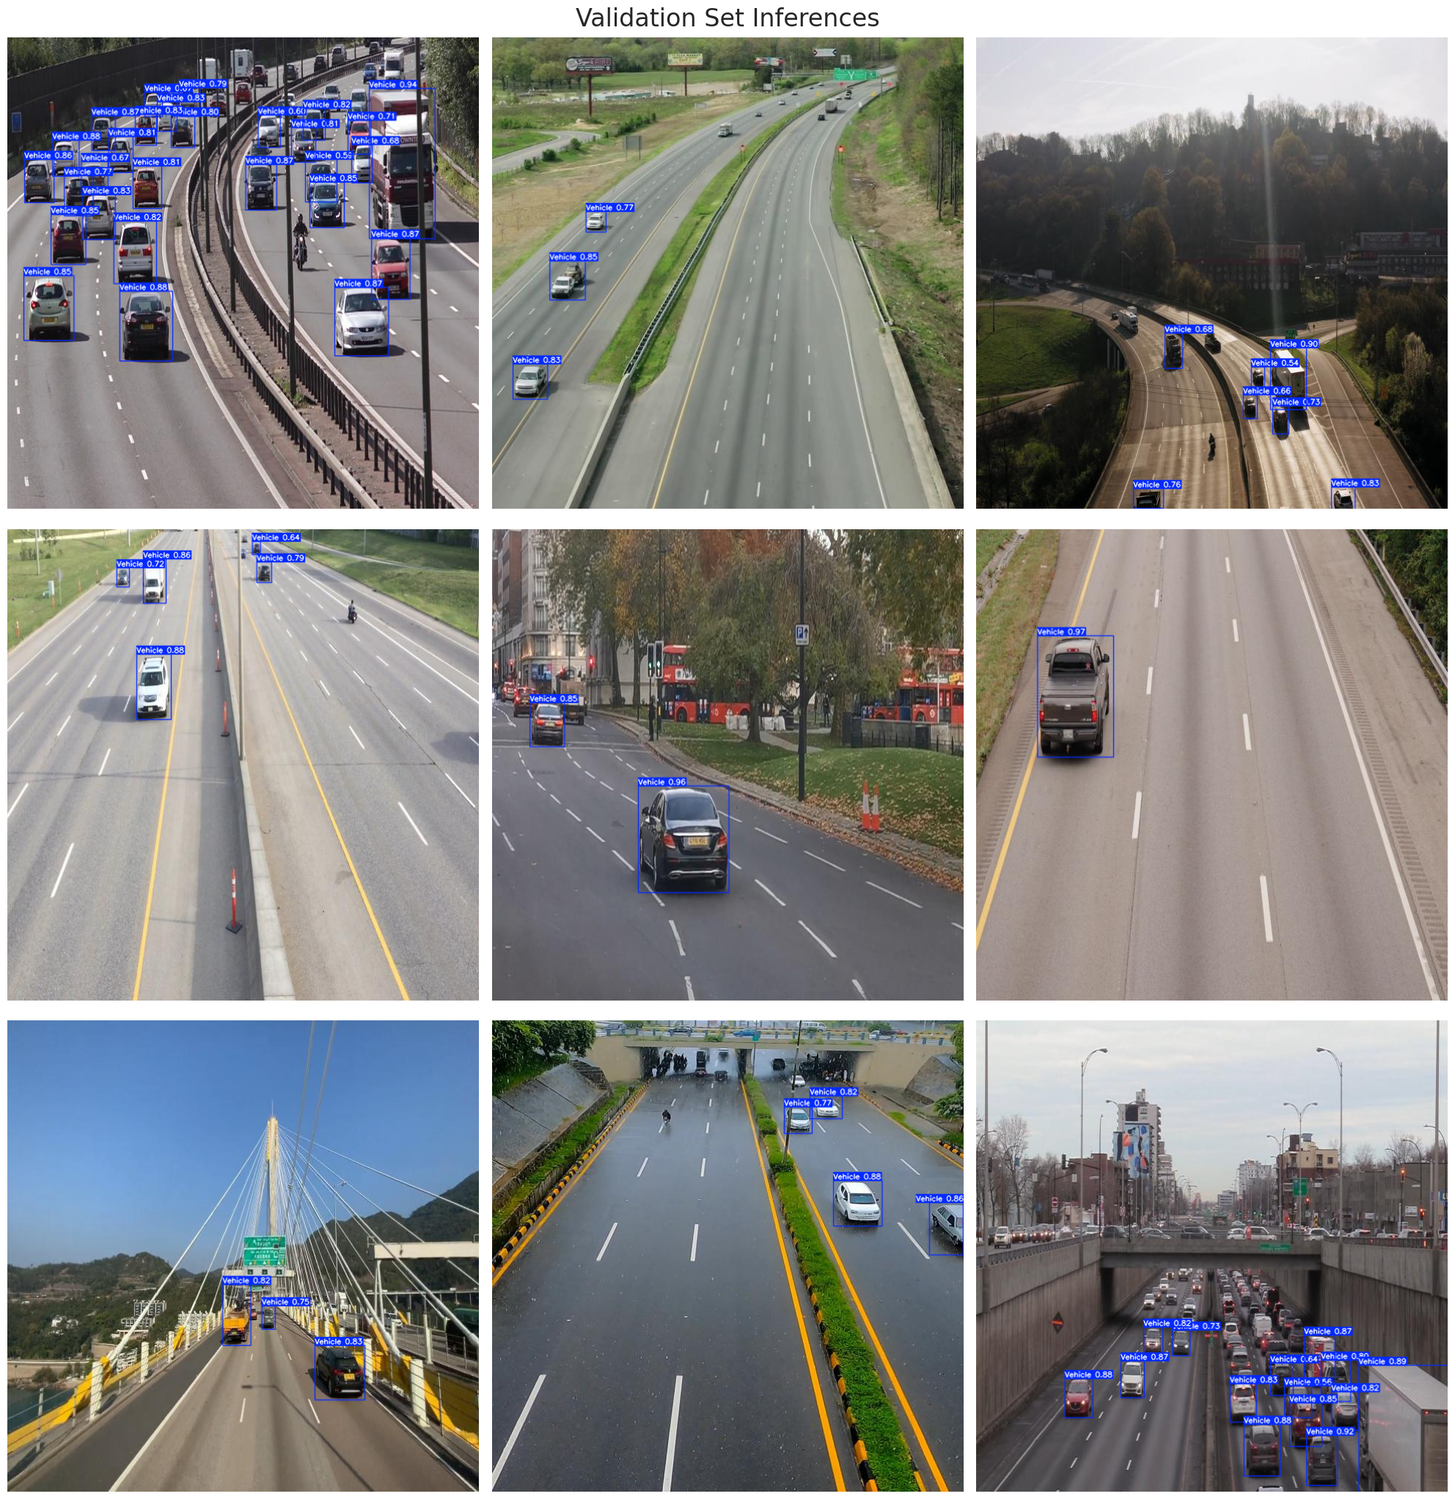
Validation image after fine tuning
Higher Confidence >> Best Object (Car) Detection

Slide 11
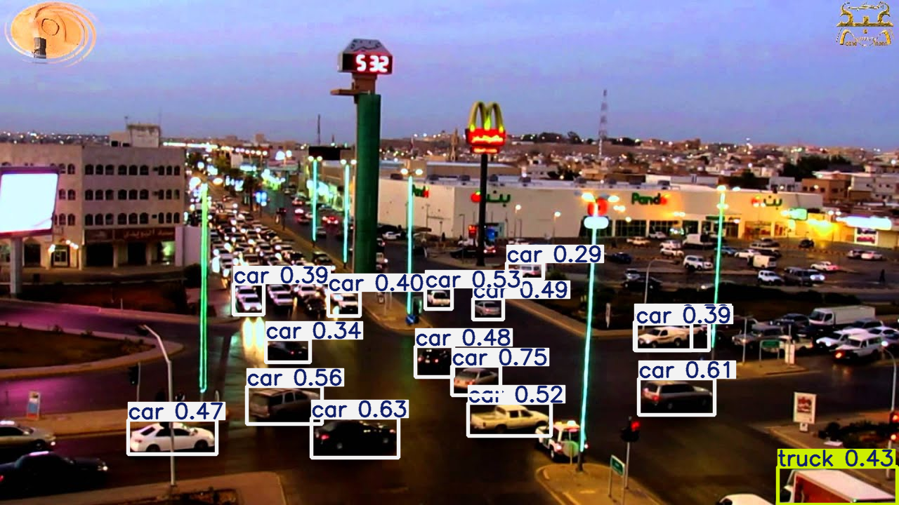
Yolo v8 on image from the web

Slide 12
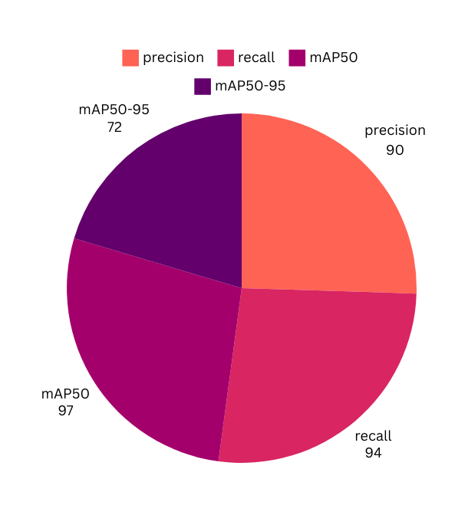
BACK TO AGENDA
Conclusion
In conclusion, our project uses YOLO's version 8 real-time detection to analyze traffic density by counting vehicles in each image. This data helps identify peak traffic points and congested areas, providing essential insights for traffic managers. Our goal is to enhance traffic management and support smarter urban planning for more efficient cities.

Slide 13
Thank You

